Slide 1
Power BI Assignment 1

Slide 2
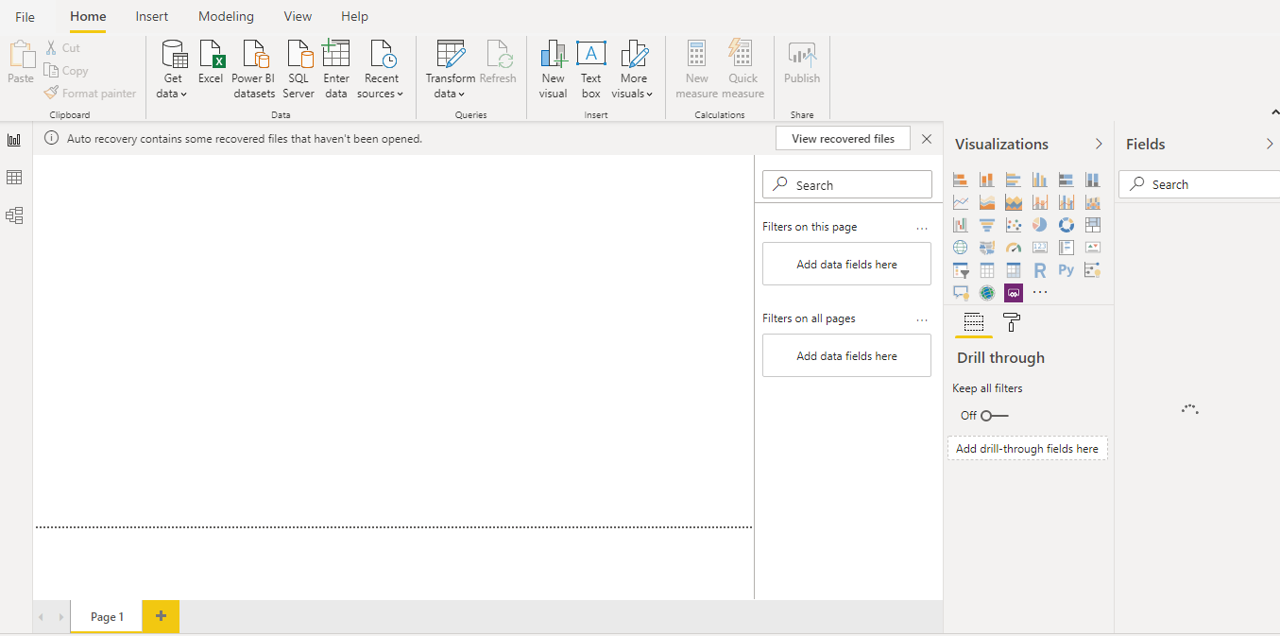
Report View

Slide 3
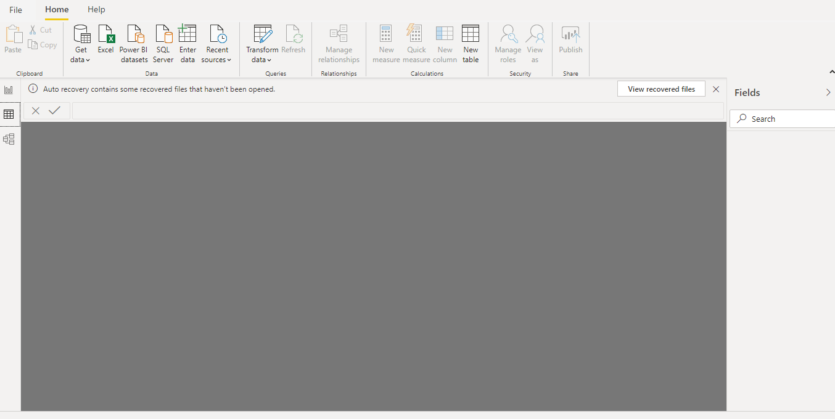
Data View

Slide 4
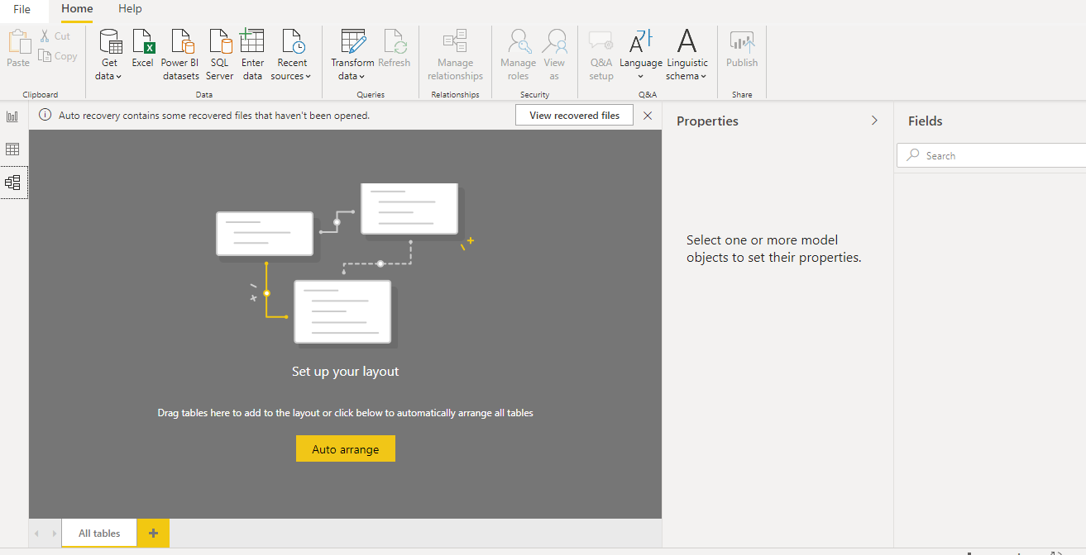
Model View

Slide 5
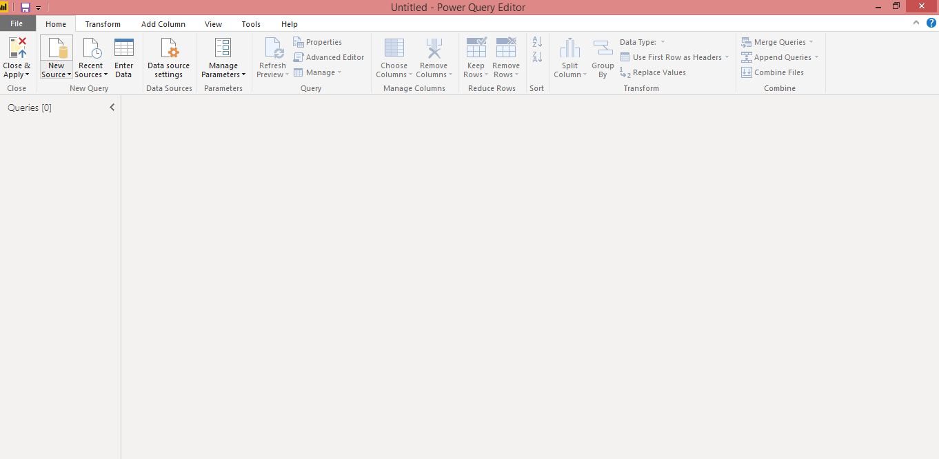
Query Editor View

Slide 6
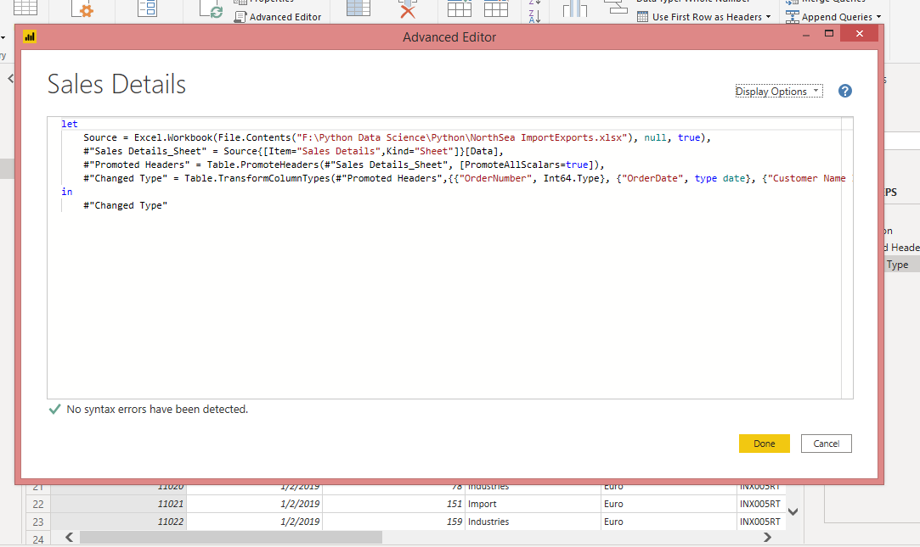
Advanced Editor View

Slide 7
Prices
Power BI Desktop − Free
Power BI Pro − Monthly $9.99
Power BI Premium- Annual $4,995

